Slide 1


Open Source Modelling in R Finance Models
Vaibhav P. Vasani
Assistant Professor
Department of Computer Engineering
K. J. Somaiya College of Engineering
Somaiya Vidyavihar University
Notes:
https://srdas.github.io/MLBook/IntroductoryRprogamming.html#data-frames

Slide 2
Finance Models
Brownian Motions: Quick Introduction
Monte Carlo
Portfolio Computations

Slide 3
Definition of Brownian motion : a random movement of microscopic particles suspended in liquids or gases resulting from the impact of molecules of the surrounding medium. — called also Brownian movement.

Slide 4

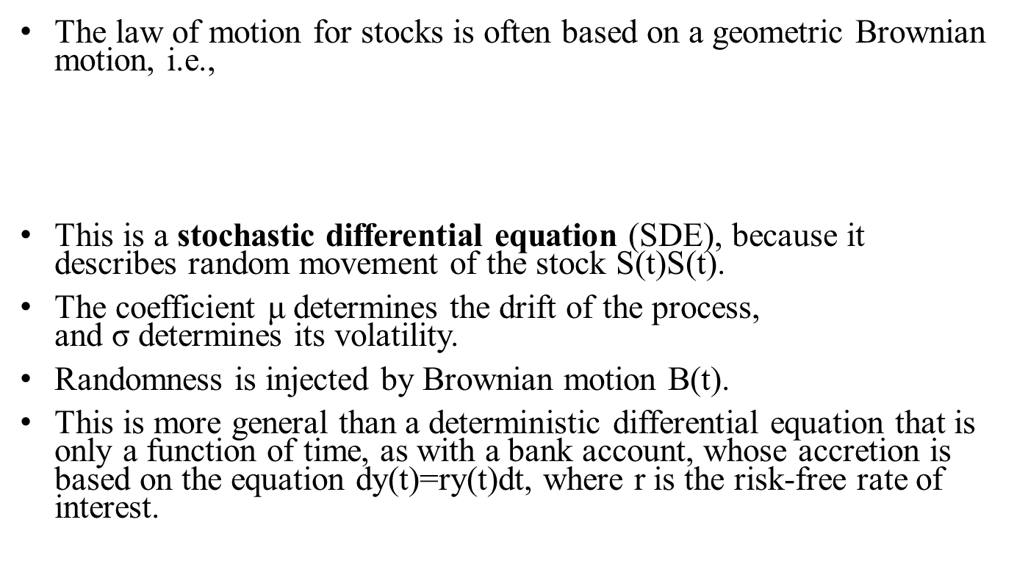
Brownian Motions
The law of motion for stocks is often based on a geometric Brownian motion, i.e.,
$dS(t)=μS(t)dt+σS(t)dB(t),S(0)=S0.$
This is a stochastic differential equation (SDE), because it describes random movement of the stock S(t)S(t).
The coefficient μ determines the drift of the process, and σ determines its volatility.
Randomness is injected by Brownian motion B(t).
This is more general than a deterministic differential equation that is only a function of time, as with a bank account, whose accretion is based on the equation dy(t)=ry(t)dt, where r is the risk-free rate of interest.

Slide 5
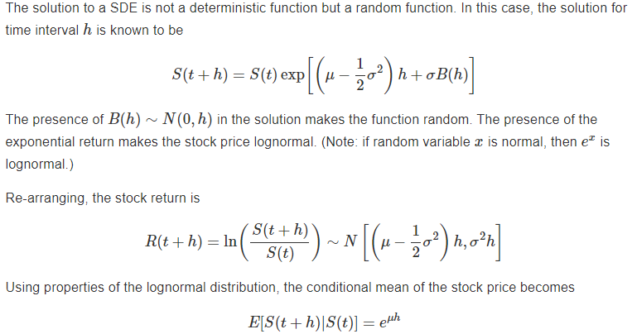

Slide 6
The following R code computes the annualized volatility σ
library(quantmod)
## Loading required package: xts
## Loading required package: zoo
##
## Attaching package: 'zoo'
## The following objects are masked from 'package:base':
##
## as.Date, as.Date.numeric
## Loading required package: TTR
## Loading required package: methods
## Version 0.4-0 included new data defaults. See ?getSymbols.
getSymbols('MSFT',src='google')

Slide 7
## As of 0.4-0, 'getSymbols' uses env=parent.frame() and
## auto.assign=TRUE by default.
##
## This behavior will be phased out in 0.5-0 when the call will
## default to use auto.assign=FALSE. getOption("getSymbols.env") and
## getOptions("getSymbols.auto.assign") are now checked for alternate defaults
##
## This message is shown once per session and may be disabled by setting
## options("getSymbols.warning4.0"=FALSE). See ?getSymbols for more details.
## [1] "MSFT“

Slide 8
stkp = MSFT$MSFT.Close
rets = diff(log(stkp))[-1]
h = 1/252
sigma = sd(rets)/sqrt(h)
print(sigma)
## [1] 0.2802329
The parameter μ is also easily estimated as
mu = mean(rets)/h+0.5*sigma^2
print(mu)
## [1] 0.1152832
So the additional term ½ (σ^2) does matter substantially.

Slide 9
Monte Carlo Simulation
A Monte Carlo simulation is a model used to predict the probability of different outcomes when the intervention of random variables is present.
Monte Carlo simulations help to explain the impact of risk and uncertainty in prediction and forecasting models.
A variety of fields utilize Monte Carlo simulations, including finance, engineering, supply chain, and science.

Slide 10

Monte Carlo Simulation
It is easy to simulate a path of stock prices using a discrete form of the solution to the Geometric Brownian motion SDE.
Note that we replaced B(h) with √eh, where e∼N(0,1).
Both B(h) and √eh have mean zero and variance h. Knowing S(t), we can simulate S(t+h) by drawing e from a standard normal distribution.

Slide 11
n = 252
s0 = 100
mu = 0.10
sig = 0.20
s = matrix(0,1,n+1)
h=1/n
s[1] = s0
for (j in 2:(n+1)) {
s[j]=s[j-1]*exp((mu-sig^2/2)*h
+sig*rnorm(1)*sqrt(h))
}
print(s[1:5])
## [1] 100.0000 100.8426 100.6249 100.6474 100.0126
print(s[(n-4):n])
## [1] 101.3609 101.0642 101.9908 101.3826 102.2418
plot(t(s),type="l",col="blue",xlab="Days",ylab="stock price"); grid(lwd=2)

Slide 12
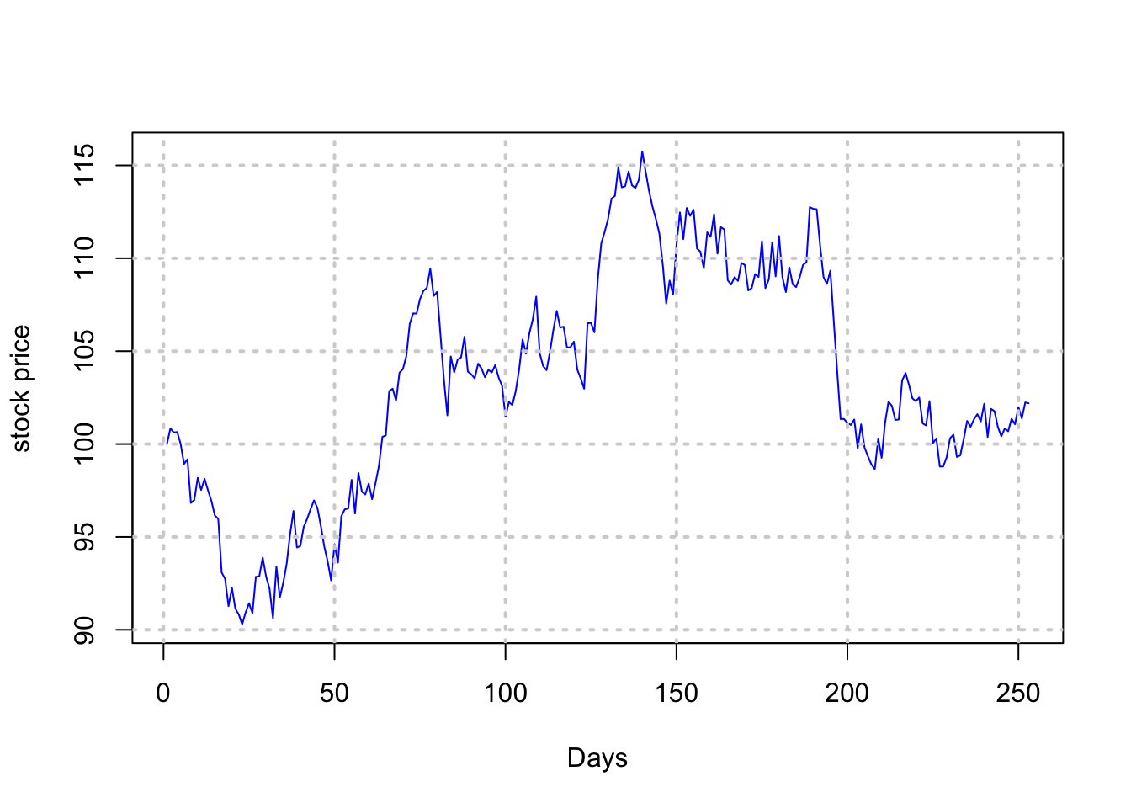

Slide 13
Vectorization
The same logic may be used to generate multiple paths of stock prices, in a vectorized way as follows. In the following example we generate 3 paths. Because of the vectorization, the run time does not increase linearly with the number of paths, and in fact, hardly increases at all.

Slide 14
s = matrix(0,3,n+1)
s[,1] = s0
for (j in seq(2,(n+1))) {
s[,j]=s[,j-1]*exp((mu-sig^2/2)*h
+sig*matrix(rnorm(3),3,1)*sqrt(h))
}
ymin = min(s); ymax = max(s)
plot(t(s)[,1],ylim=c(ymin,ymax),type="l",xlab="Days",ylab="stock price"); grid(lwd=2)
lines(t(s)[,2],col="red",lty=2)
lines(t(s)[,3],col="blue",lty=3)

Slide 15
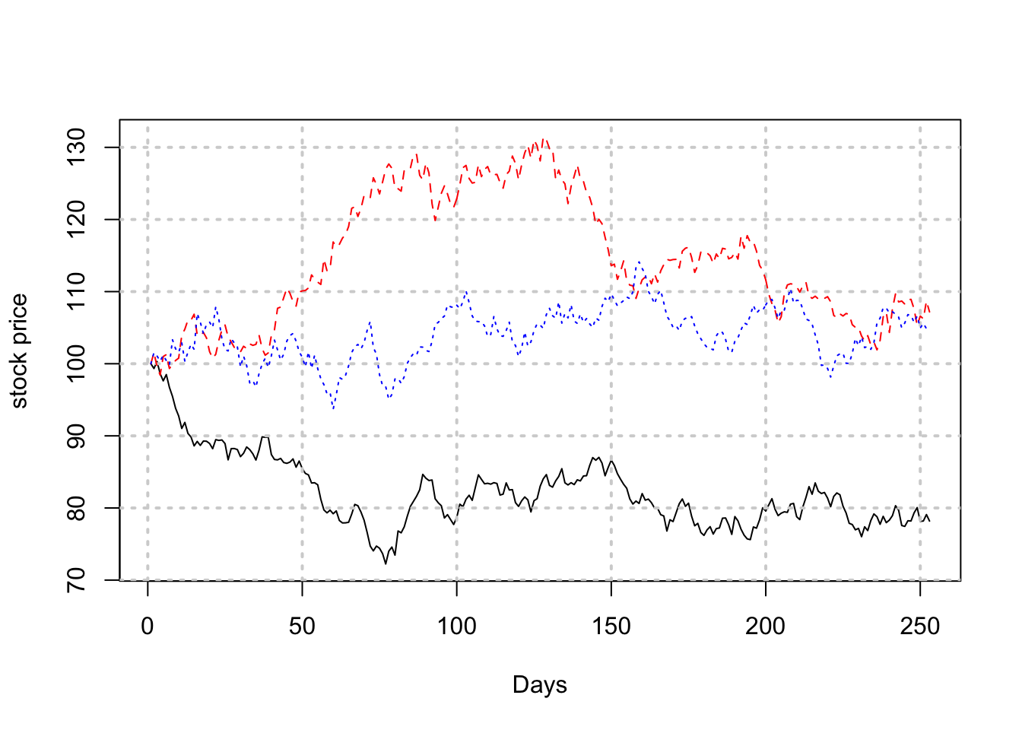

Slide 16
Home work
If you generate many more paths, how can you find the probability of the stock ending up below a defined price? Can you do this directly from the discrete version of the Geometric Brownian motion process above?

Slide 17

Bivariate random variables
To convert two independent random variables e1,e2)∼N(0,1) into two correlated random variables (x1,x2) with correlation ρ, use the following trannsformations.

Slide 18
e = matrix(rnorm(20000),10000,2)
print(cor(e))
## [,1] [,2]
## [1,] 1.0000000000 0.0003501396
## [2,] 0.0003501396 1.0000000000
print(cor(e[,1],e[,2]))
## [1] 0.0003501396
We see that these are uncorrelated random variables.

Slide 19
Now we create a pair of correlated variates using the formula above.
rho = 0.6
x1 = e[,1]
x2 = rho*e[,1]+sqrt(1-rho^2)*e[,2]
cor(x1,x2)
## [1] 0.5941021

Slide 20
print(mean(x1))
## [1] -0.01568866
print(mean(x2))
## [1] 0.0004103859
print(var(x1))
## [1] 0.993663
print(var(x2))
## [1] 1.014452
print(cov(x1,x2))
## [1] 0.5964806

Slide 21
Multivariate random variables
These are generated using Cholesky decomposition. We may write a covariance matrix in decomposed form, i.e., Σ=LL′, where L is a lower triangular matrix.
Alternatively we might have an upper triangular decomposition, where U=L′.
Think of each component of the decomposition as a square-root of the covariance matrix.

Slide 22
#Original matrix
cv = matrix(c(0.01,0,0,0,0.04,0.02,0,0.02,0.16),3,3,byrow=TRUE)
print(cv)
## [,1] [,2] [,3]
## [1,] 0.01 0.00 0.00
## [2,] 0.00 0.04 0.02
## [3,] 0.00 0.02 0.16
#Let's enhance it
cv[1,2]=0.005
cv[2,1]=0.005
cv[1,3]=0.005
cv[3,1]=0.005
print(cv)
## [,1] [,2] [,3]
## [1,] 0.010 0.005 0.005
## [2,] 0.005 0.040 0.020
## [3,] 0.005 0.020 0.160

Slide 23
We now compute the Cholesky decomposition of the covariance matrix.
L = t(chol(cv))
print(L)
## [,1] [,2] [,3]
## [1,] 0.10 0.00000000 0.0000000
## [2,] 0.05 0.19364917 0.0000000
## [3,] 0.05 0.09036961 0.3864367

Slide 24
The Cholesky decomposition is now used to generate multivariate random variables with the correct correlation.
e = matrix(rnorm(3*10000),10000,3)
x = t(L %*% t(e))
print(dim(x))
## [1] 10000 3
print(cov(x))
## [,1] [,2] [,3]
## [1,] 0.009857043 0.004803601 0.005329556
## [2,] 0.004803601 0.040708872 0.021150791
## [3,] 0.005329556 0.021150791 0.161275573
In the last calculation, we confirmed that the simulated data has the same covariance matrix as the one that we generated correlated random variables from.

Slide 25
Portfolio Computations
Let’s enter a sample mean vector and covariance matrix and then using some sample weights, we will perform some basic matrix computations for portfolios to illustrate the use of R.

Slide 26
mu = matrix(c(0.01,0.05,0.15),3,1)
cv = matrix(c(0.01,0,0,0,0.04,0.02,
0,0.02,0.16),3,3)
print(mu)
## [,1]
## [1,] 0.01
## [2,] 0.05
## [3,] 0.15
print(cv)
## [,1] [,2] [,3]
## [1,] 0.01 0.00 0.00
## [2,] 0.00 0.04 0.02
## [3,] 0.00 0.02 0.16
w = matrix(c(0.3,0.3,0.4))
print(w)
## [,1]
## [1,] 0.3
## [2,] 0.3
## [3,] 0.4

Slide 27
The expected return of the portfolio is
muP = t(w) %*% mu
print(muP)
## [,1]
## [1,] 0.078
And the standard deviation of the portfolio is
stdP = sqrt(t(w) %*% cv %*% w)
print(stdP)
## [,1]
## [1,] 0.1868154
We thus generated the expected return and risk of the portfolio, i.e., the values 0.0780.078 and 0.1870.187, respectively.

Slide 28
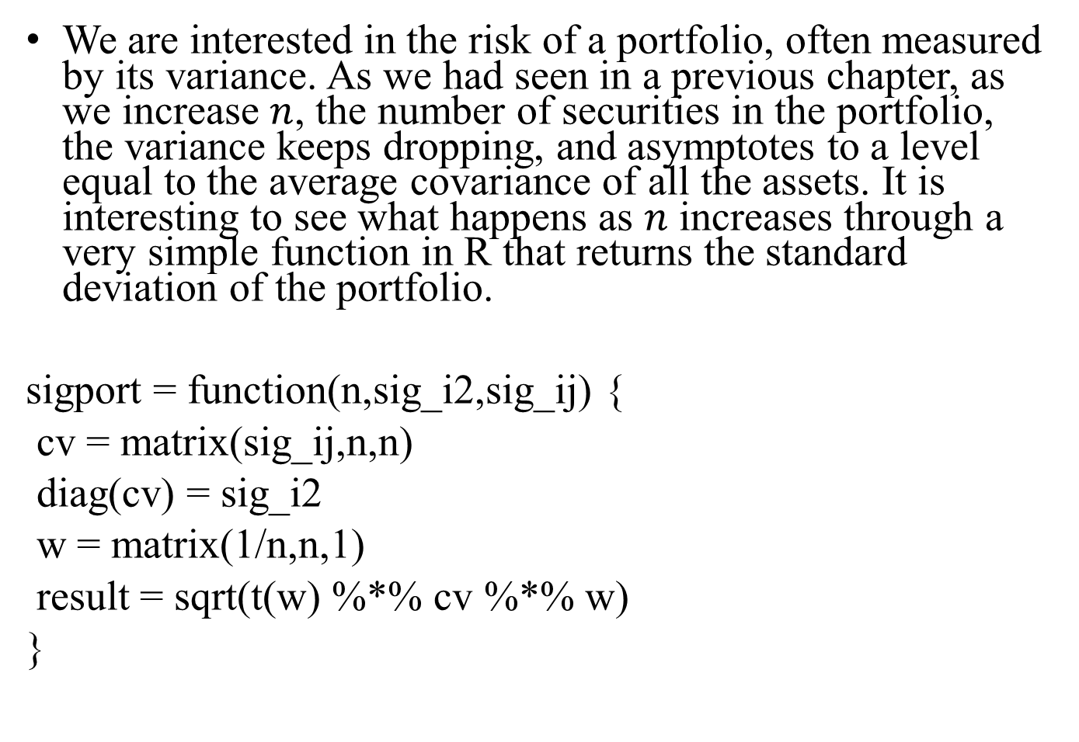
We are interested in the risk of a portfolio, often measured by its variance. As we had seen in a previous chapter, as we increase $n$, the number of securities in the portfolio, the variance keeps dropping, and asymptotes to a level equal to the average covariance of all the assets. It is interesting to see what happens as $n$ increases through a very simple function in R that returns the standard deviation of the portfolio.
sigport = function(n,sig_i2,sig_ij) {
cv = matrix(sig_ij,n,n)
diag(cv) = sig_i2
w = matrix(1/n,n,1)
result = sqrt(t(w) %*% cv %*% w)
}

Slide 29
We now apply it to increasingly diversified portfolios.
n = seq(5,100,5)
risk_n = NULL
for (nn in n) {
risk_n = c(risk_n,sigport(nn,0.04,0.01))
}
print(risk_n)
## [1] 0.1264911 0.1140175 0.1095445 0.1072381 0.1058301 0.1048809 0.1041976
## [8] 0.1036822 0.1032796 0.1029563 0.1026911 0.1024695 0.1022817 0.1021204
## [15] 0.1019804 0.1018577 0.1017494 0.1016530 0.1015667 0.1014889
We can plot this to see the classic systematic risk plot. Systematic risk declines as the number of stocks in the portfolio increases.
plot(n,risk_n,type="l",ylab="Portfolio Std Dev")

Slide 30
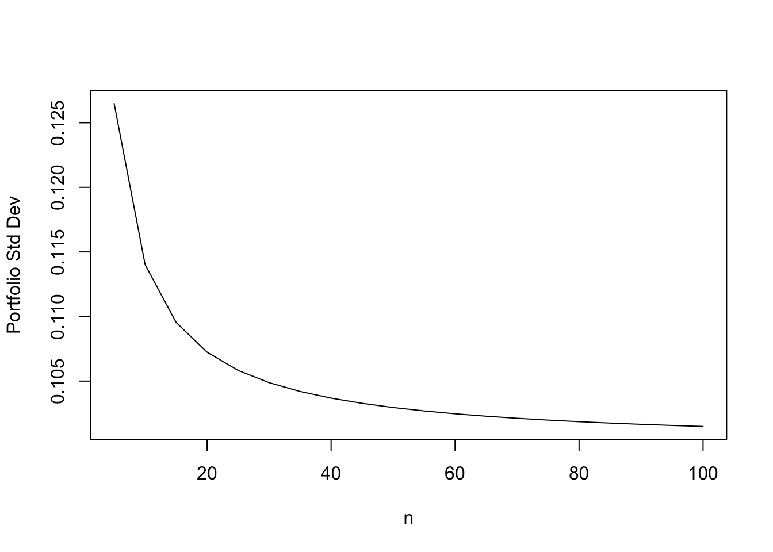

Slide 31
Question
?

